Slide 1

Distributed photovoltaic generation impact on fault location in radial distribution networks
Rodrigo Rianelly

Slide 2
Introduction
Based on [Kumar and Saxena 2016], the addition of distributed photovoltaic generation in a radial distribution network results in numerous technical challenges for its operation, one of them being fault location.
Changes in the values of fault current, short circuit power, impedance relay reach, voltage profile.
Islanding and reverse power flow become a problem.
Coordination becomes disrupted.
Modern approaches to fault location in this scenario are based on power frequency, travelling waves, signal injection or machine learning.

Slide 3
Objective
Verify the influence of distributed photovoltaic generation in fault location based on machine learning in a radial distribution network.

Slide 4
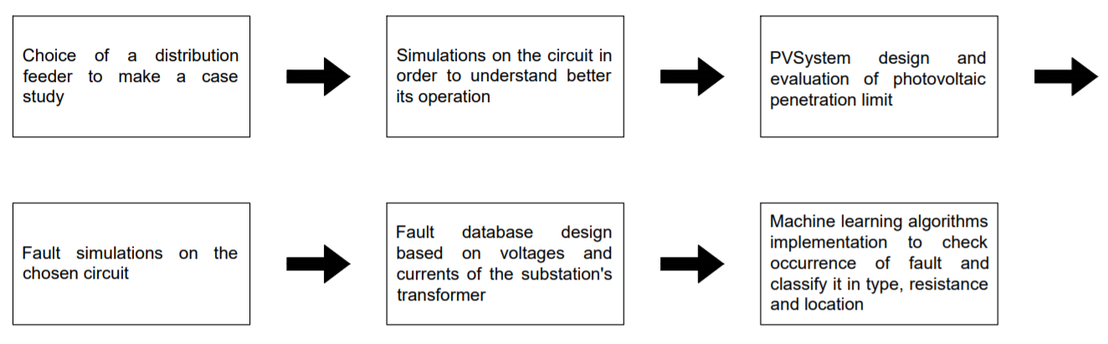
Methodology

Slide 5
Tools
Open Distribution System Simulator (OpenDSS):
snapshot and daily power flow;
fault object;
PVSystem object;
dynamic-link library (DLL);
bus georeferencing.
Python 3:
packages for graphic elaboration, numeric computation, DLL integration, data management and machine learning.

Slide 6
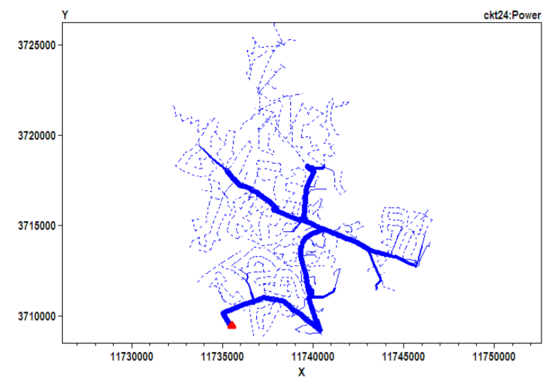
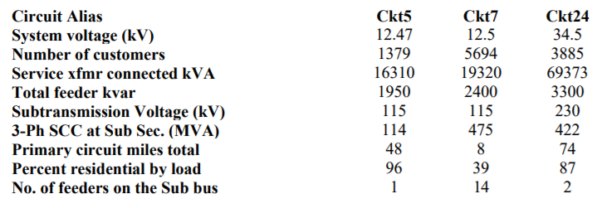
The circuit
[EPRI]
[EPRI]

Slide 7
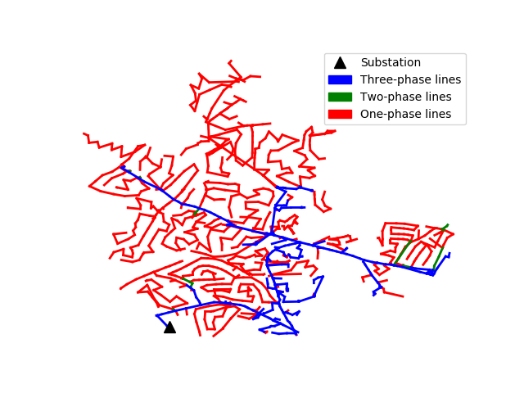
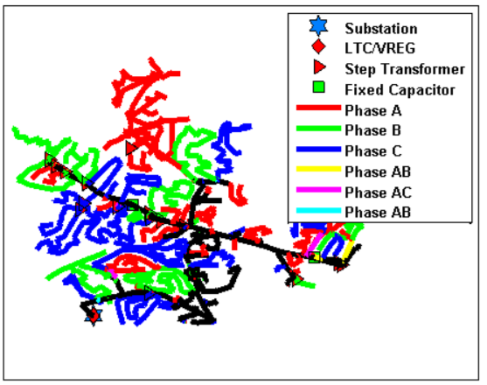
The circuit
[Matthew J. Reno 2013]

Slide 8
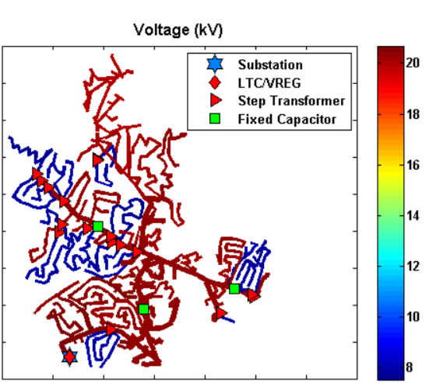
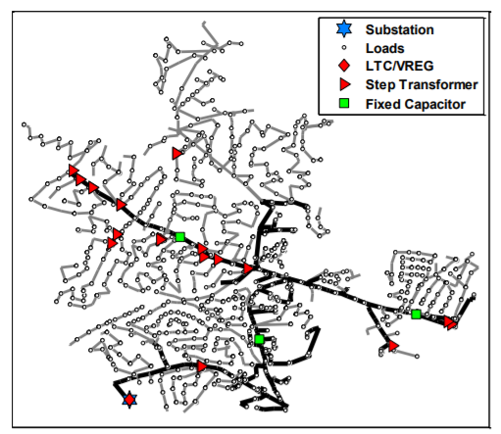
The circuit
[Matthew J. Reno 2013]
[Matthew J. Reno 2013]

Slide 9
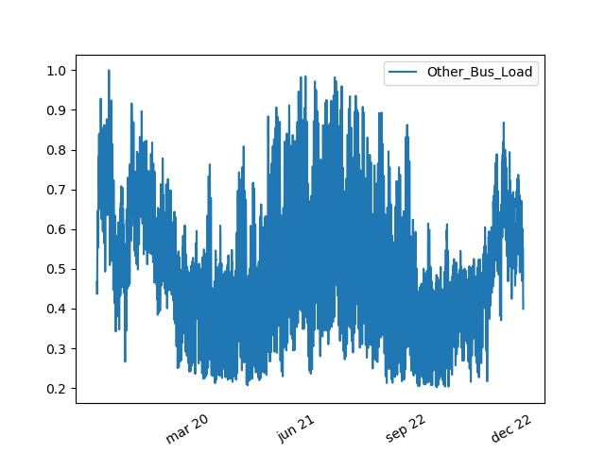
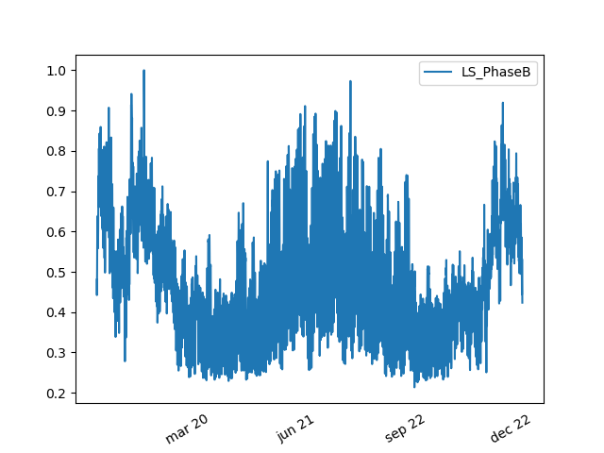
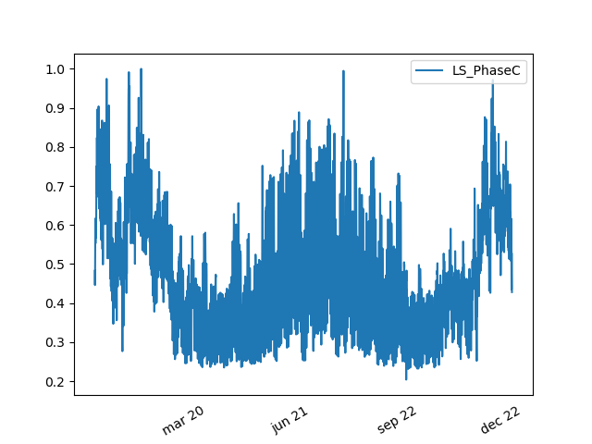

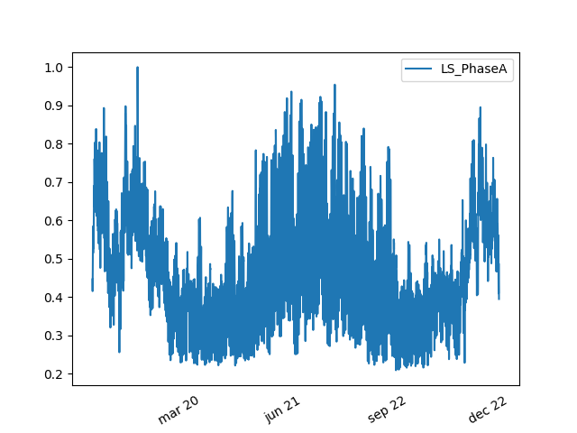
Yearly loadshape (pu x hours)
Spring: begins at march 20th.
Summer: begins at june 21st
Autumn: begins at september 23rd.
Winter: begins at december 22nd.

Slide 10
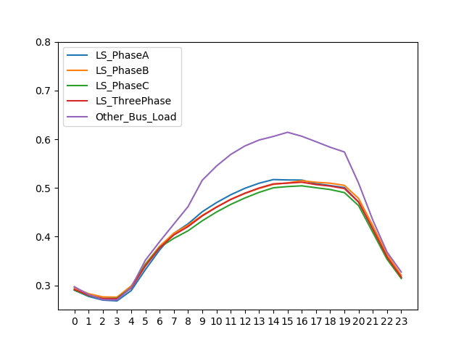
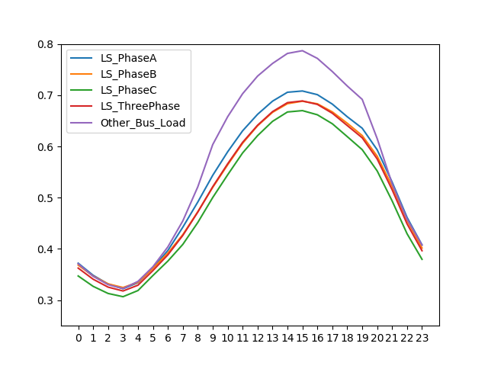
Loadshape for a typical day of a season (pu x hours)
Spring
Summer

Slide 11
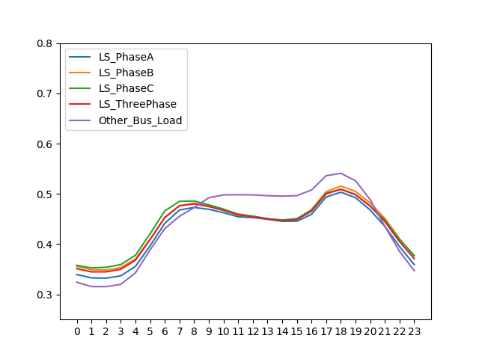
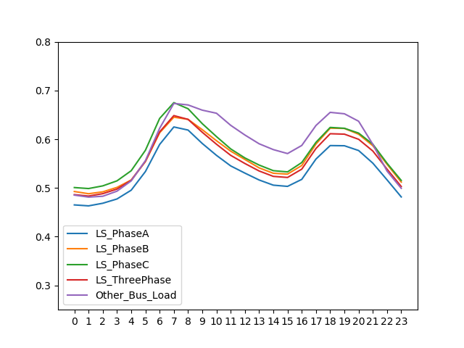
Loadshape for a typical day of a season (pu x hours)
Autumn
Winter

Slide 12
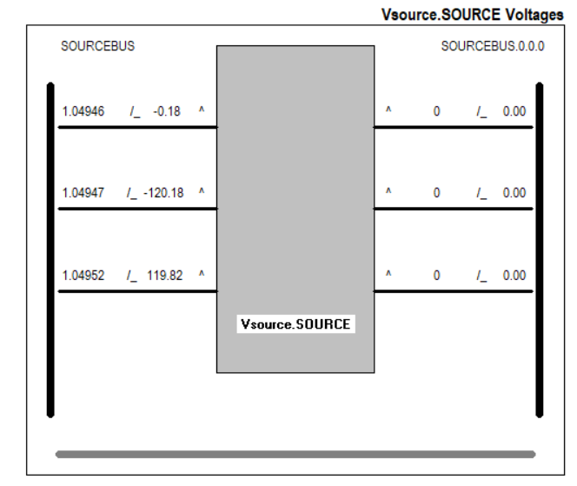
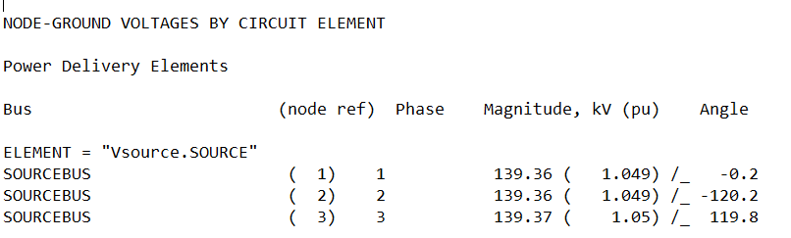
The circuit - voltage
Source voltage at 11 o’clock in a typical spring day.

Slide 13
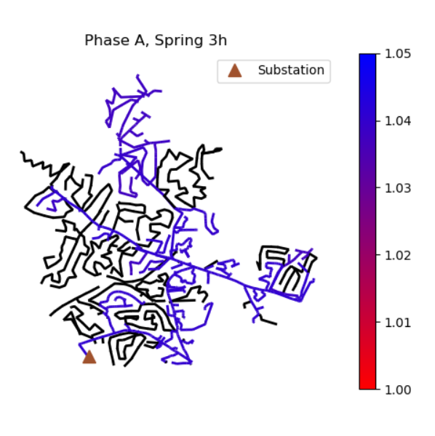
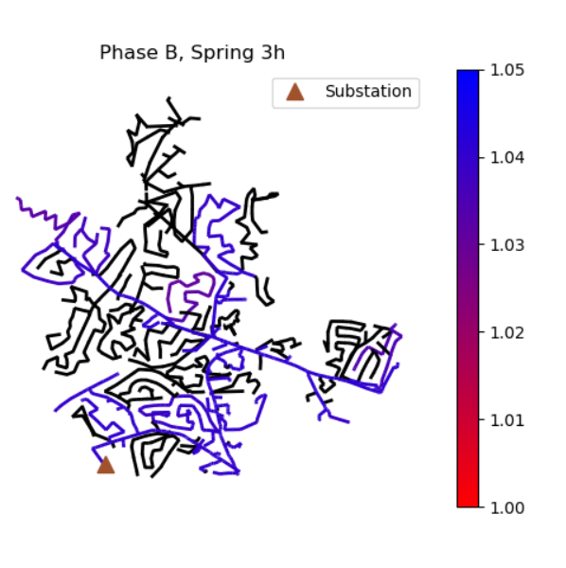
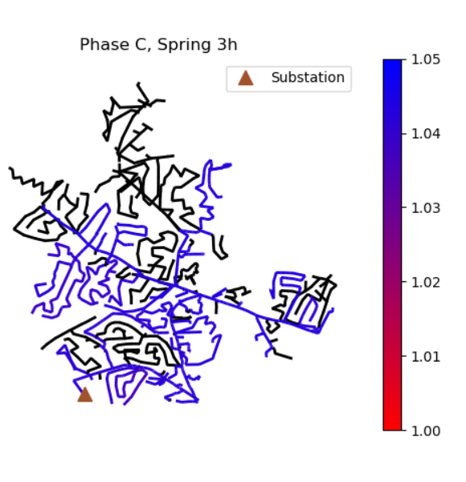
The circuit – voltage (pu) – minimum load – 3h (spring)

Slide 14
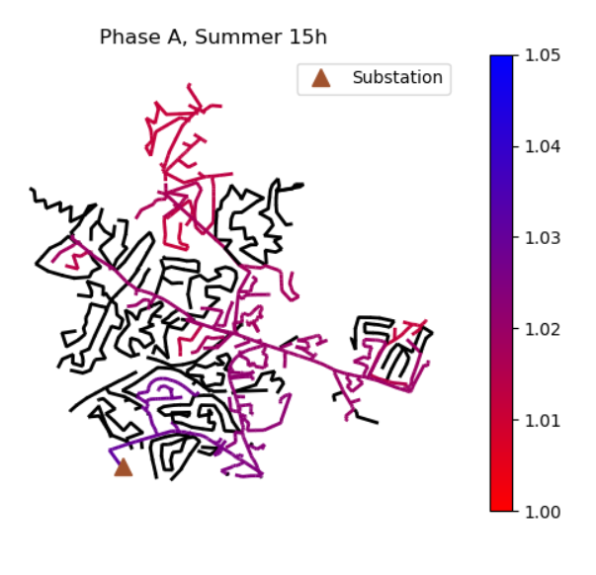
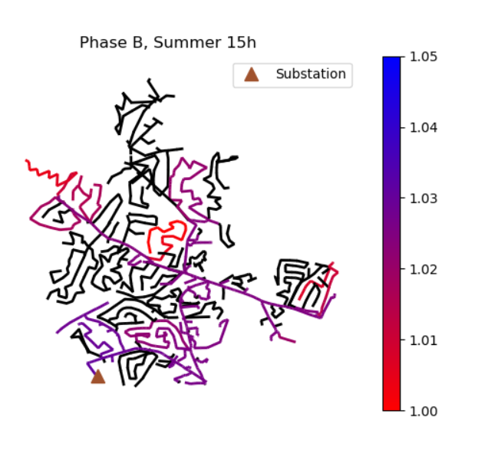
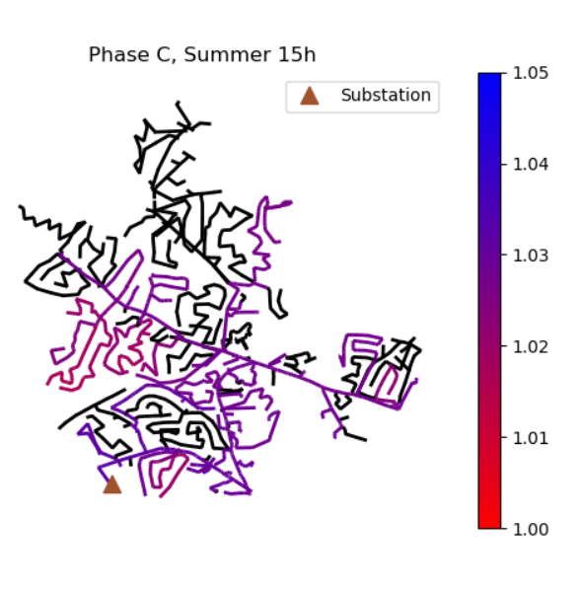
The circuit – voltage (pu) – maximum load – 15h (summer)

Slide 15
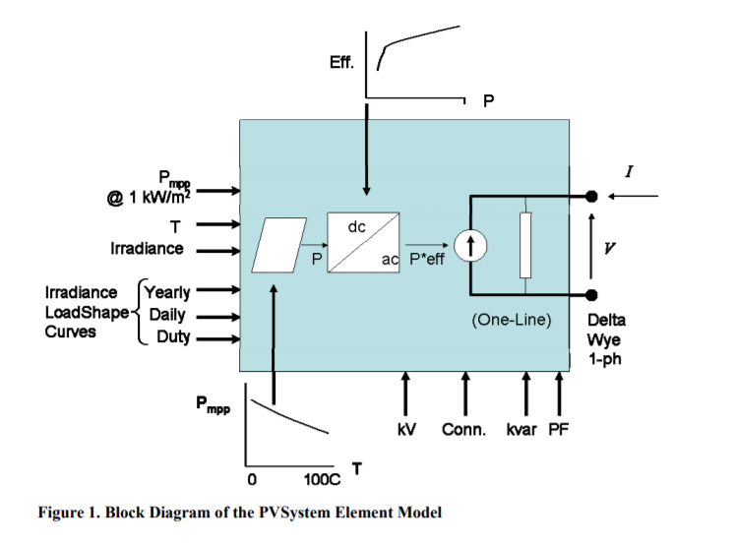
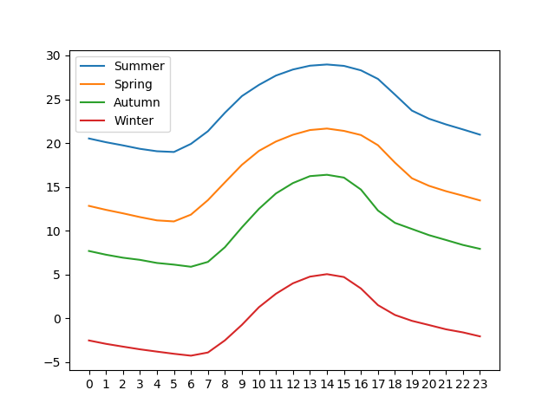
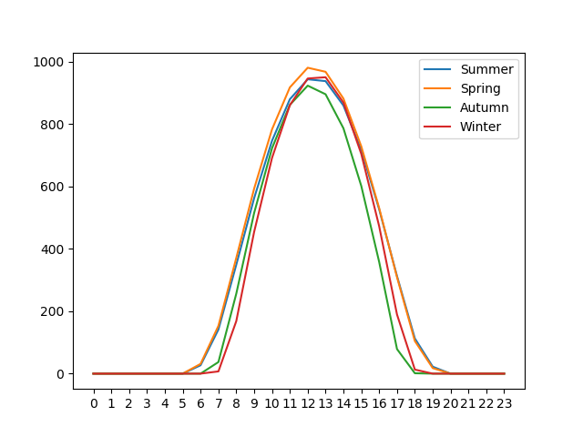
Photovoltaic systems dimensioning on OpenDSS
W/m² x hours
°C x hours
[EPRI 2011]

Slide 16
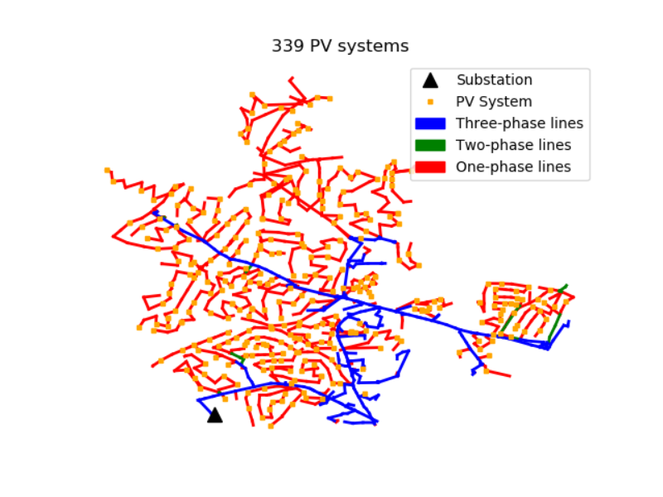
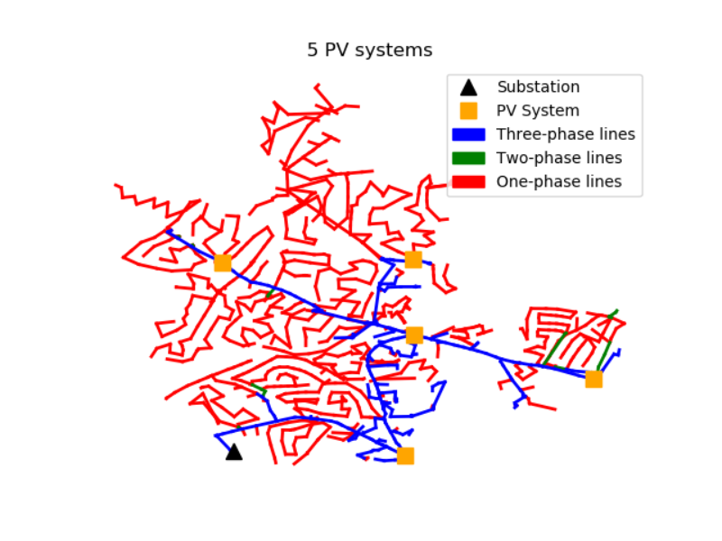

Distributed photovoltaic generation proposed cases

Slide 17
Penetration limit
In the ckt24 case, the penetration limit was decided mainly by comparing voltage variation amongst the buses. A comparison was done between the pu value of all buses in the case with no PV and the PVSystem cases, in different hours and seasons.
Case with 1 PVSytem: 8.5 MW.
Case with 5 PVSystems: 1.5 MW each.
Case with 339 PVSystems: 15 kW each.

Slide 18
Difference in power flow
Case with 339 PV systems
Case with 5 PV systems
Case with 1 PV system

Slide 19
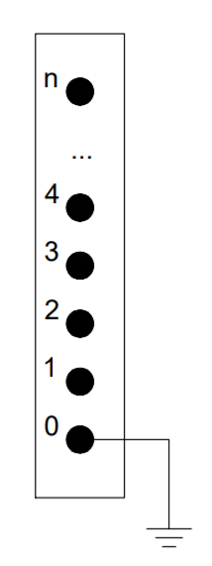
Buses on OpenDSS
Buses are infinite on OpenDSS, and node 0 is connected to ground by default.
They are created as parameters of an element (generator, transformer, line, load...)

Slide 20
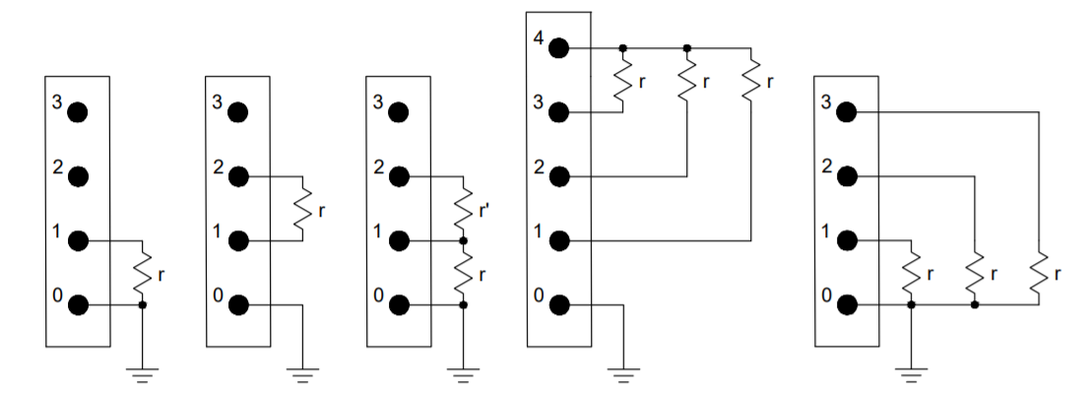
Fault elements
1φ
2φ
2φT
3φ
3φT

Slide 21
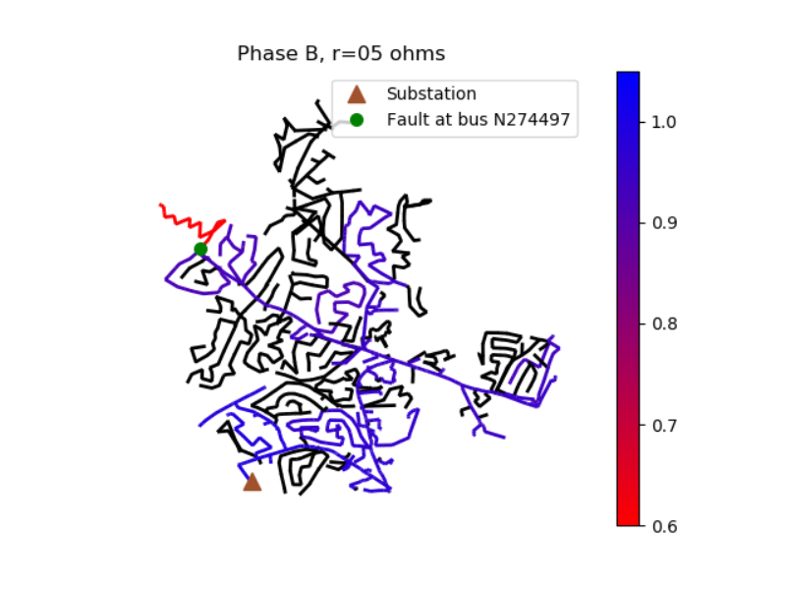
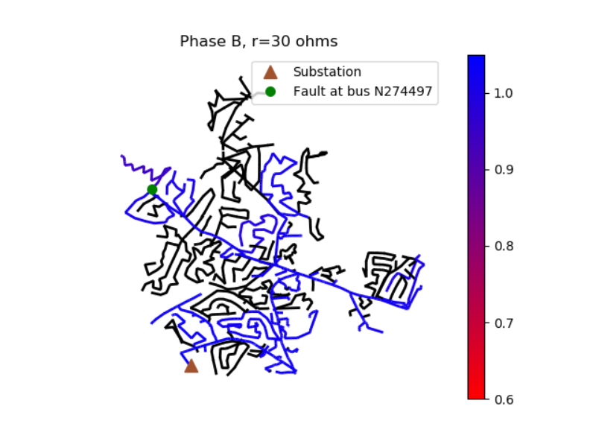
LG fault on phase B with different resistances – voltage (pu)

Slide 22
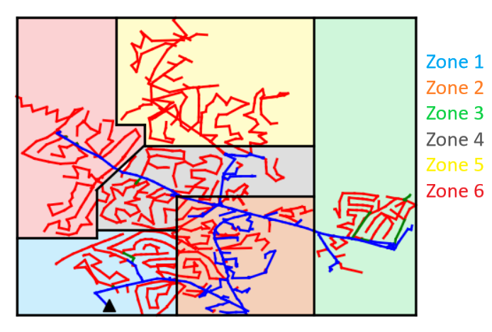
EPRI ckt24 separation in zones

Slide 23
Data extracted from simulations
Labels:
fault type;
season;
hour;
bus which fault ocurred;
coordinates of bus which fault ocurred;
zone which fault occurred;
phase(s) involved into fault (when necessary).
Results:
Voltages and currents on the substation transformer.

Slide 24
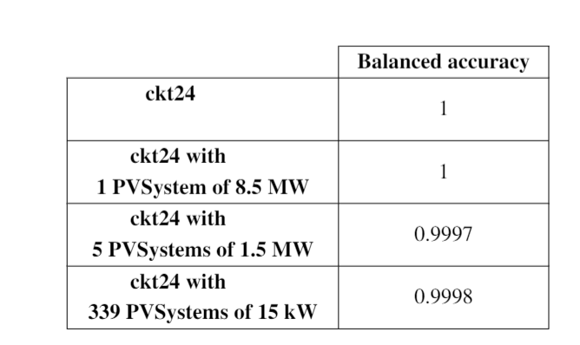
Fault detection MLPs performance

Slide 25
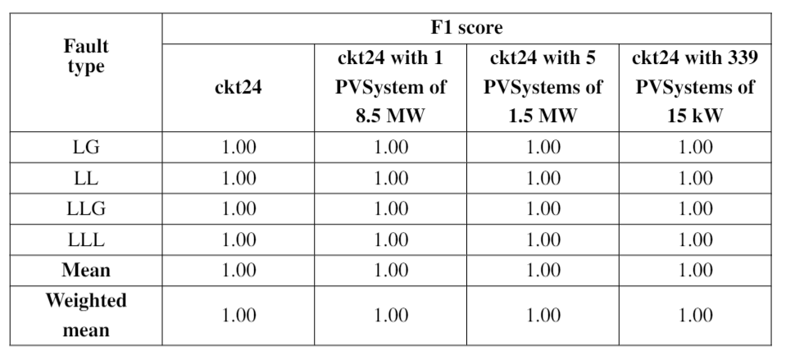
Fault type MLPs performance

Slide 26
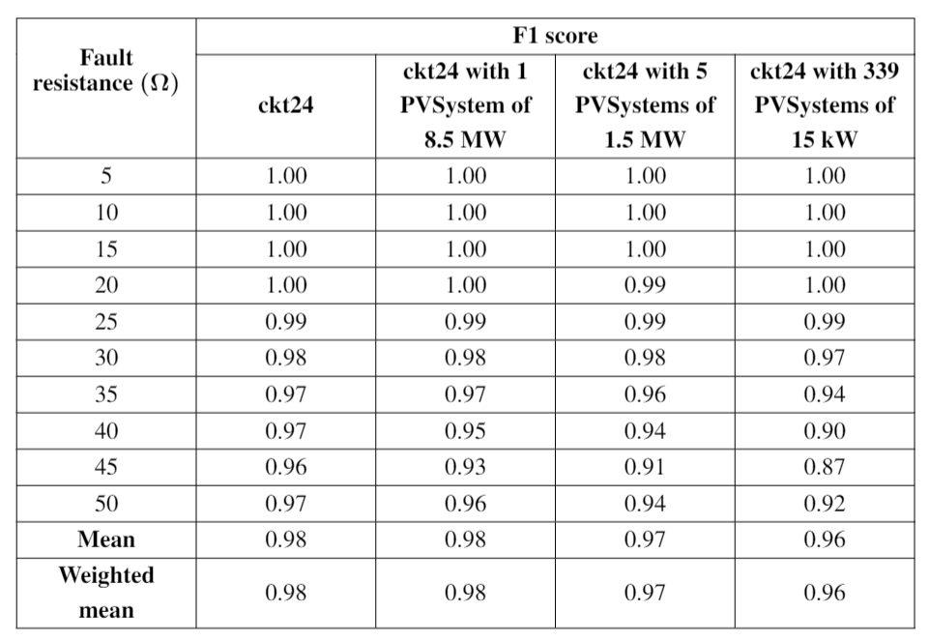
Fault resistance MLPs performance

Slide 27
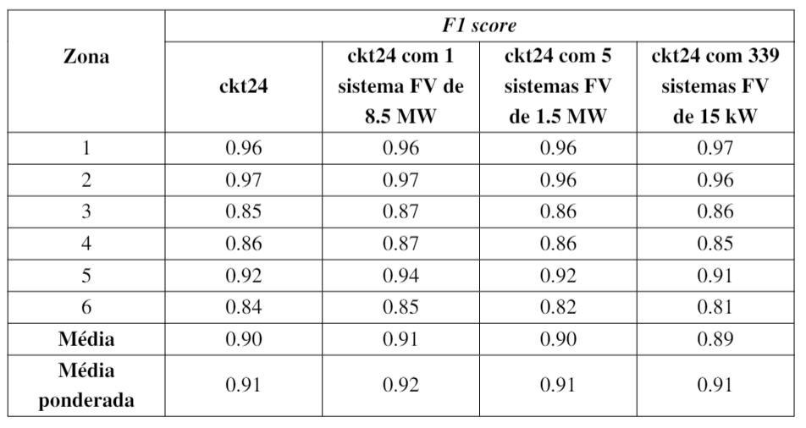
Fault location MLPs performance

Slide 28
Conclusions
A better understanding of the necessary parameters in order to proper model PV systems in radial distribution networks was provided.
It was possible to estimate a penetration limit for different cases of PVSystems inserted in ckt24.
The distributed generation behavior was measured for different cases in ckt24.
Classifier algorithms to check occurrence of fault, its type and resistance work pretty well on ckt24.
Classifier algorithms to check fault location on ckt24, despite having a 90% average success rate, still need improvement.

Slide 29
Future proposals
Study of different leves of photovoltaic penetration.
Fault location study in ring configuration networks.
Measurement of currents and voltages in more than one location.
Consideration of weekend loadshapes.
Separation of EPRI ckt24 in more than 6 zones.
Separation of EPRI ckt24 using clusters.
Integration with power system protection equipments.

Slide 30
Bibliographic references
[Duffie and Beckman 2013] Duffie, J. A., & Beckman, W. A. (2013). Solar engineering of thermal processes. John Wiley & Sons.
[EPRI] EPRI. Summary of epri test circuits. http://svn.code.sf.net/p/electricdss/code/trunk/Distrib/EPRITestCircuits/Readme.pdf.
[EPRI 2011] EPRI (2011). Opendss pvsystem element model. http://svn.code.sf.net/p/electricdss/code/trunk/Distrib/Doc/OpenDSS%20PVSystem%20Model.pdf.
[Géron 2017] Géron, A. (2017). Hands-on machine learning with Scikit-Learn and TensorFlow: concepts, tools, and techniques to build intelligent systems. " O'Reilly Media, Inc.".
[Goodfellow et al. 2016] Goodfellow, I., Bengio, Y., and Courville, A. (2016). Deep Learning. MIT Press. http://www.deeplearningbook.org.

Slide 31
Bibliographic references
[Kumar and Saxena 2016] Kumar, R., & Saxena, D. (2016, November). Fault location in distribution network with distributed generation: An overview and key issues. In Power India International Conference (PIICON), 2016 IEEE 7th (pp. 1-6). IEEE.
[Lemaître et al. 2017] Lemaître, G., Nogueira, F., & Aridas, C. K. (2017). Imbalanced-learn: A python toolbox to tackle the curse of imbalanced datasets in machine learning. The Journal of Machine Learning Research, 18(1), 559-563.
[Meeus 1991] Meeus, J. H. (1991). Astronomical algorithms. Willmann-Bell, Incorporated.
[Pedregosa et al. 2011] Pedregosa, F., Varoquaux, G., Gramfort, A., Michel, V., Thirion, B., Grisel, O., ... & Vanderplas, J. (2011). Scikit-learn: Machine learning in Python. Journal of machine learning research, 12(Oct), 2825-2830.
[PRODIST 2012] PRODIST, A. (2012). Procedimentos de Distribuição de Energia Elétrica no Sistema Elétrico Nacional, Módulo 8-Qualidade da Energia Elétrica.

Slide 32
Bibliographic references
[Reno and Coogan 2013] Reno, M. J., & Coogan, K. (2013). Grid integrated distributed PV (GridPV). Sandia National Laboratories SAND2013-6733.
[Sengupta et al. 2018] Sengupta, M., Xie, Y., Lopez, A., Habte, A., Maclaurin, G., & Shelby, J. (2018). The national solar radiation data base (NSRDB). Renewable and Sustainable Energy Reviews, 89, 51-60.
[Shayani 2010] Shayani, R. A. (2010). Método para determinação do limite de penetração da geração distribuída fotovoltaica em redes radiais de distribuição.
[Stein 2012] Stein, J. S. (2012, June). The photovoltaic performance modeling collaborative (PVPMC). In Photovoltaic Specialists Conference (PVSC) (pp. 003048-003052).

